Slide 1



FBE 551 Quantitative Investing
Team: Fat Finger
Team Members:
Imani Mufti
Jacob Lee
Leon Man
Roman Sielewicz
Selene Xiang

Slide 2
Agenda
1. Data Description
3. Implementation
What does the data look like?
Mean-reversion strategy
Momentum
Volatility
2. Research
4. Testing
Literature Review
Algorithmic trading in the futures/energy market
Mean-reverting performance
Momentum performance
Volatility performance

Slide 3
SECTION 01
Data Description

Slide 4
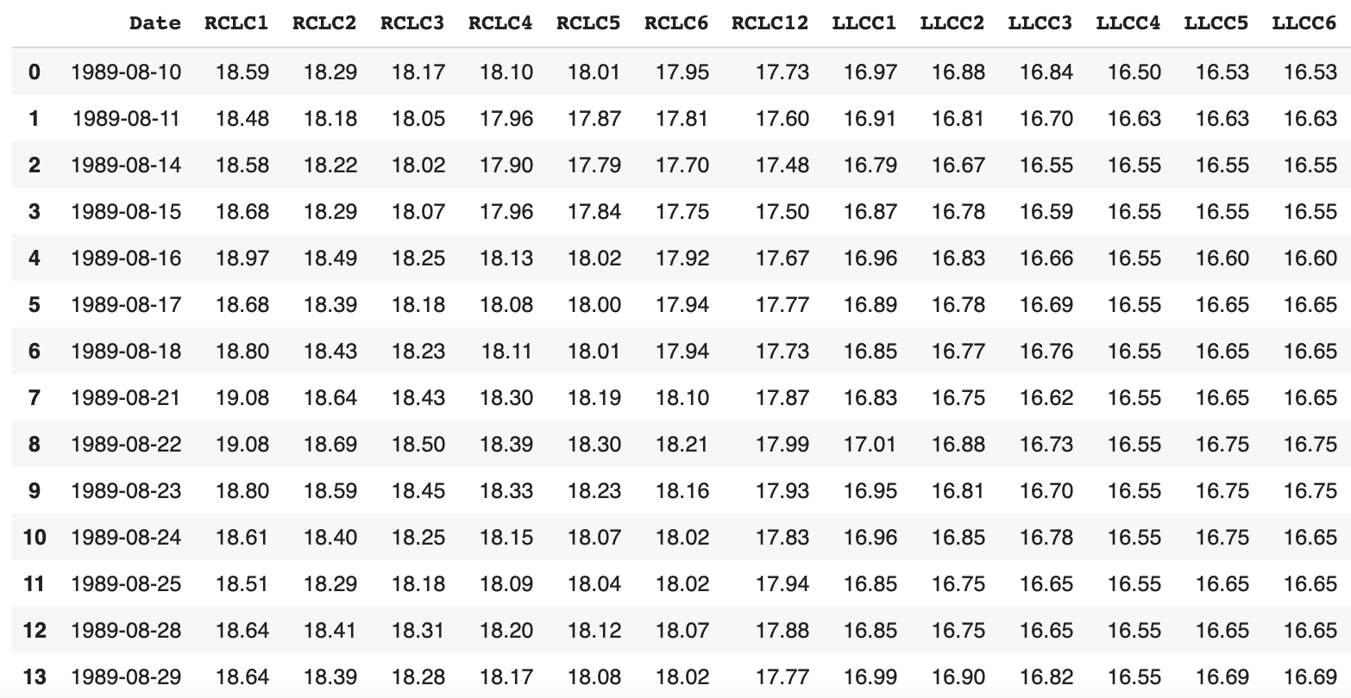
1. Data Description
Energy futures market data is from the paper published by Lubnau and Todorova (2015)
The dataset includes daily settlement price of futures contracts with delivery months for WTI, Brent, Natural Gas, Heating Oil and Gasoline.
According to the data providers, the futures continuous price series are constructed by rolling over on the first trading day of the month.
All futures contracts were traded almost around the clock at the CME (both Globex and ClearPort Electronic Platforms)
Snapshot of Oil Futures Contracts
Table 1. The Summary of All Four Employed Futures Contracts
Futures Contract (frequency) | Dataset Time Horizon
Crude Oil (daily) | 08/10/1989 – 02/18/2014
Gasoline (daily) | 10/03/2005 - 02/18/2014
Heating oil (daily) | 01/01/1986 - 02/18/2014
Natural gas (daily) | 08/13/1990 – 02/18/2014
Notes:
WTI Crude Oil Contract Specs: https://www.cmegroup.com/trading/energy/crude-oil/light-sweet-crude_contract_specifications.html
Brent Crude Oil Contract Specs: https://www.cmegroup.com/trading/energy/crude-oil/brent-crude-oil_contract_specifications.html
https://www.eia.gov/todayinenergy/detail.php?id=34372
https://www.eia.gov/todayinenergy/detail.php?id=33752

Slide 5
1. Contract Specs
Price quotation: Dollars & cents per barrel
Contract unit: 1000 barrels
Trading hours: Sunday - Friday (break on Saturday) Around the clock except for a 1 hour break starting 4pm EST
Settlement method: Deliverable (i.e. free-on-board at any pipeline or storage facility in Cushing, Oklahoma for WTI)
TAS (Trade at settlement): VWAP during the last 2 minutes of trading hours of each day
Notes:
WTI Crude Oil Contract Specs: https://www.cmegroup.com/trading/energy/crude-oil/light-sweet-crude_contract_specifications.html
Brent Crude Oil Contract Specs: https://www.cmegroup.com/trading/energy/crude-oil/brent-crude-oil_contract_specifications.html
https://www.eia.gov/todayinenergy/detail.php?id=34372
https://www.eia.gov/todayinenergy/detail.php?id=33752

Slide 6
SECTION 02
Research
Literature Review
How does the trend look like over time and how are trading signals generated?
Can naïve buy-and-holding strategy make profits?

Slide 7
2. Literature Review
Girma and Paulson (1999)
Spreads between petroleum futures are highly cointegrated and stationary
Historically, profitable opportunities existed using moving average strategies and were statistically significant.
Shambora and Rossiter (2007)
Used an ANN model with moving average crossover inputs to generate trading signals
Highly significant sharpe ratio and profitability
Tabak and Cajueiro (2007)
Tests for long memory (long-range dependence) in WTI/Brent futures
“Can past prices predict future prices?”
Weak-form efficiency has gotten stronger over time, (especially in the WTI)
However, there is still evidence of long-range dependency
Ramirez and Rodriguez (2008)
Crude oil markets exhibit a time-varying short-term inefficient behavior that becomes efficient in the long term
Koch (2014)
Extreme price changes (tail events) cannot be fully explained by supply/demand fundamentals
Changes in net position of large hedge funds are associated with large positive/negative returns in oil markets
Speculator liquidity (TED Spread) highly associated with extreme price falls
Notes:
1.US shale oil production
2.Headwind to the price of WIT contracts
3.WTI oil contracts still trade at the discount of Brent Crude oil contract

Slide 8
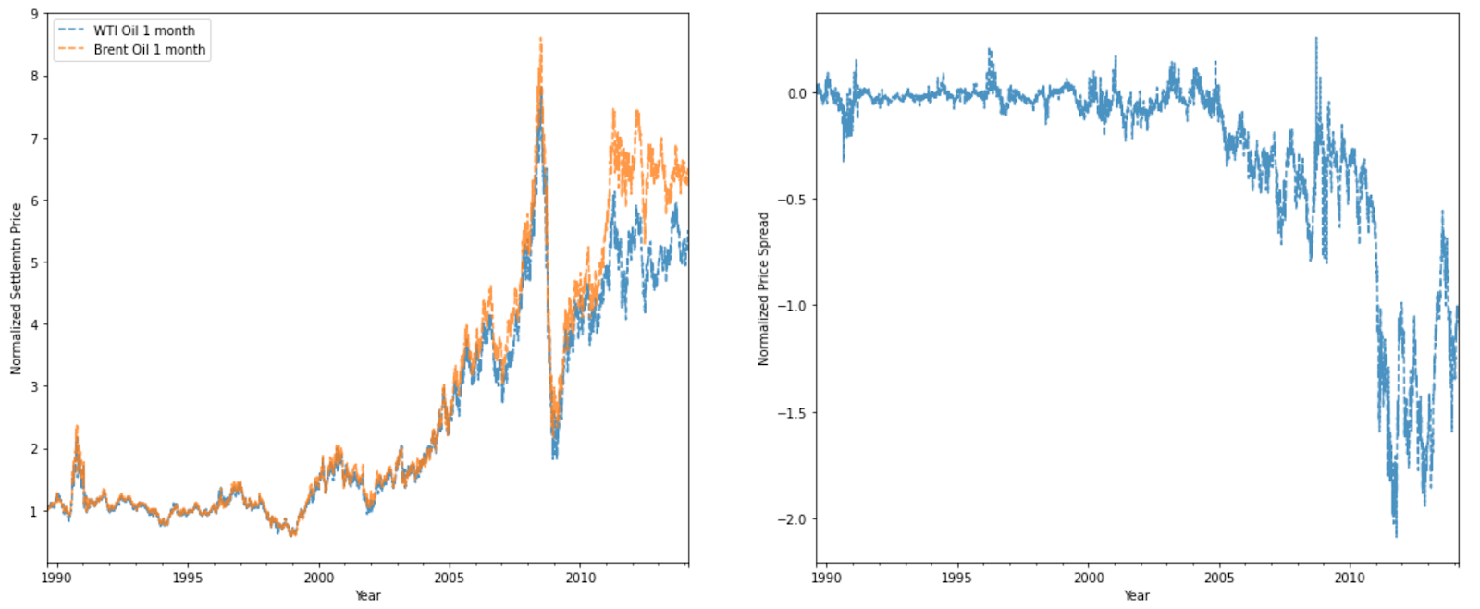
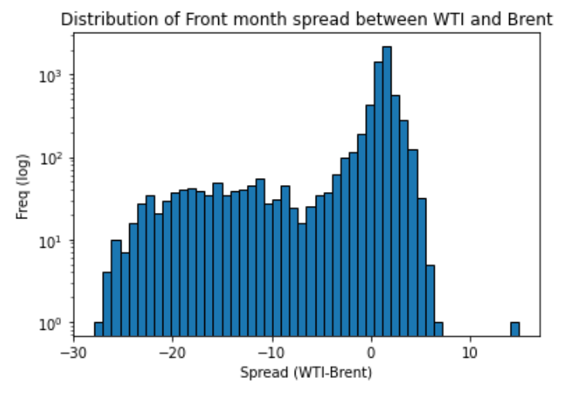
2. Research
What does the trend look like over time?
Front-month WTI and Brent Futures Price
Spread
Histogram of Front-month Spread Distribution
The US shale oil revolution
increases the supply of WTI
creates less dependency of prices between US crude oil and European crude oil
The US ban on crude oil exports (between 1975 and 2015) and was lifted in Dec 2015
Notes:
1.US shale oil production
2.Headwind to the price of WIT contracts
3.WTI oil contracts still trade at the discount of Brent Crude oil contract

Slide 9
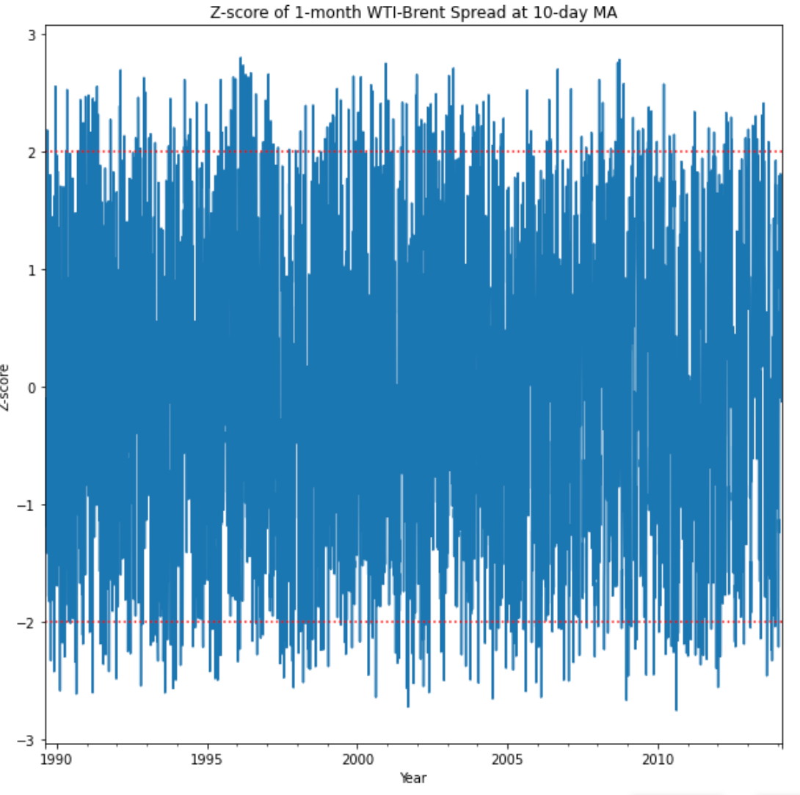
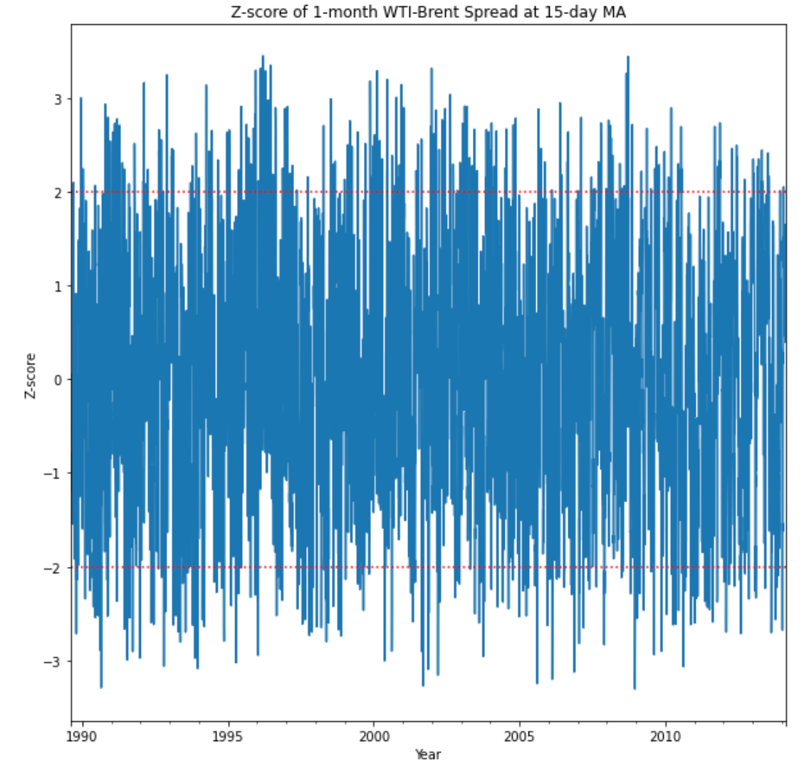
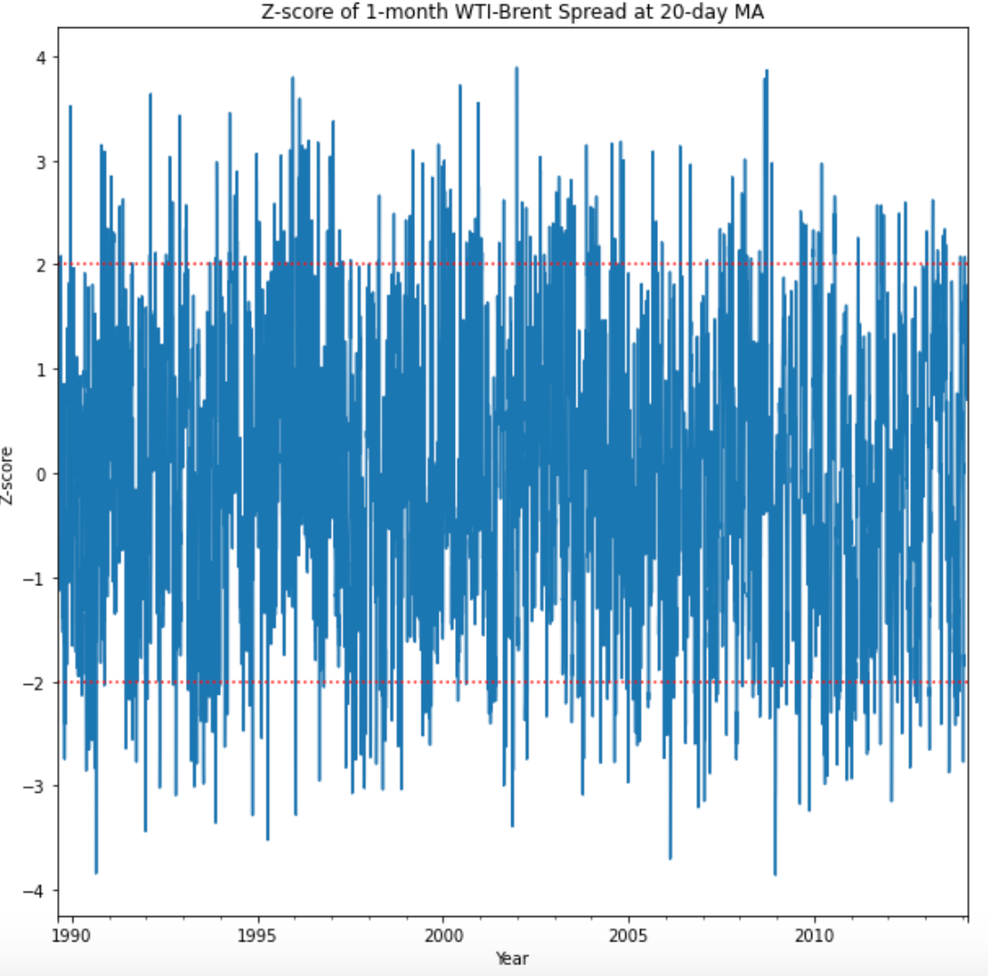
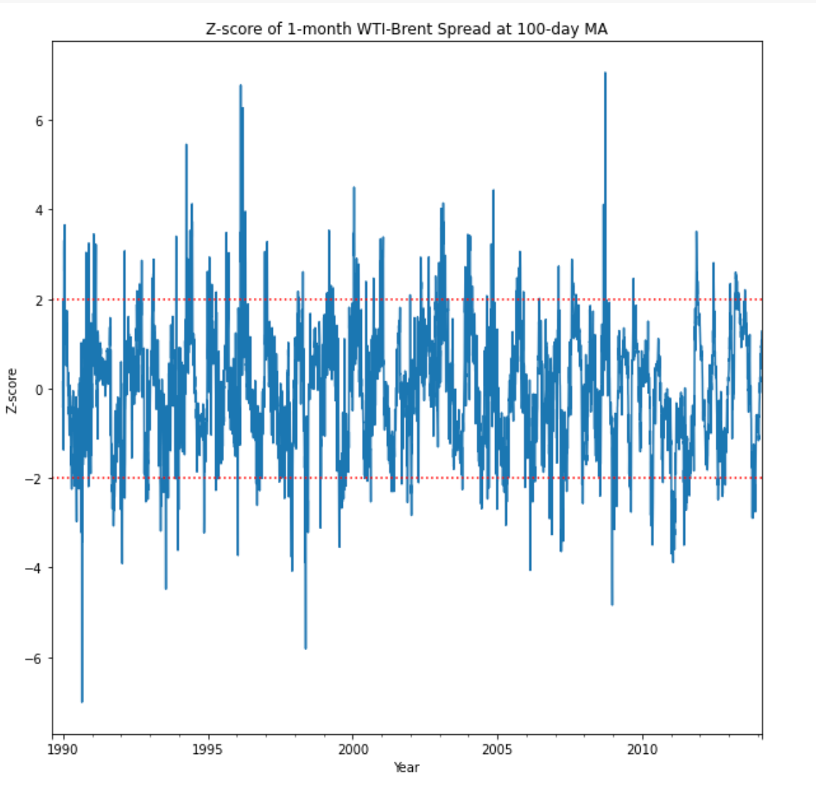
2. Research
How are the trading signals generated?
Z-score of WTI and Brent Futures Price Spread
10 MA
15 MA
20 MA
100 MA
The shorter MA window period applied, more trading signals (entry and exit) can be caught
MA window period and trading signals cutoff will be adjusted in implementation and testing
Mean-reverting trading strategies should be viable in our case （No distinct patterns shown）

Slide 10
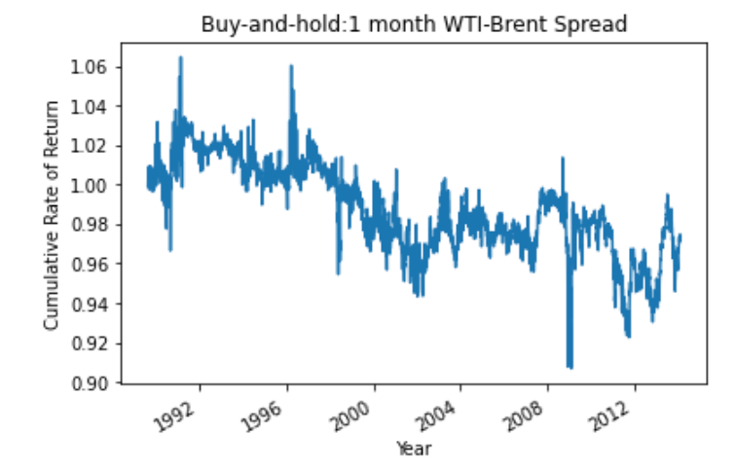
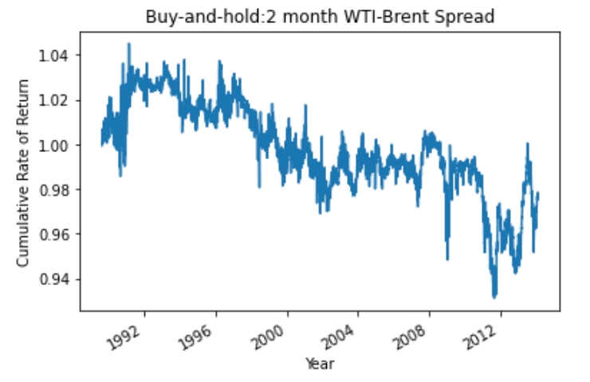
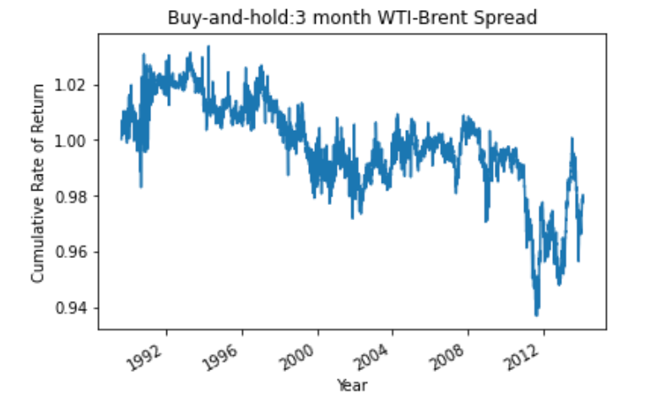
2. Research
Naïve Buy-and-hold Trading Strategy
Annualized Sharpe Ratio (Buy and Hold after Risk-free Rate)
Period | Before 1997 | Before 2000 | Before 2008 | The Entire Dataset
1-month WIT-Brent Spread | -0.465 | -0.574 | -0.478 | -0.381
2-month WIT-Brent Spread | -0.608 | -0.753 | -0.660 | -0.548
3-month WIT-Brent Spread | -0.674 | -0.833 | -0.713 | -0.600
It is difficult to earn profits through naively buying and holding the spread.
It is believed that the oil futures markets should be efficient in the long term, but subject to short-term information shocks (we try to leverage these opportunities)

Slide 11
SECTION 03
Implementation

Slide 12
3. Mean-Reversion Strategy
Since we learned in our research that the spread between energy futures tend to be stationary, we implemented the following strategy:
Trade the spread between two futures contracts
Spread = β₁*Futures A - β₂*Futures B
Types of spreads:
Inter-commodity spreads
same delivery period, different products
Calendar spreads
same products, different delivery periods
Products traded:
NYMEX WTI (US-based crude oil)
ICE Brent (European-based crude oil)
delivery periods ranging from (1-month to 1-year)
Hedge Ratio
1:1 ratio (β₁ = β₂ = 1)
Dynamic hedge ratio (updates everyday using a Kalman Filter)
** although same day trades are possible, all signals were lagged by 1 day for a conserative approach

Slide 13
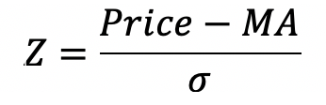
3. Entry & Exit signals
Z = 0
Exit 1b
(base case)
Rolling Mean
z = 2
Entry 2:
Short position
z = -0.2
Exit 1a
(undershoot)
z = 0.2
Exit 1c
(overshoot)
z = -2
Entry 1:
Long position
Entry: Z > 2 | Z < -2
Exit: Z ≈ 0
(around zero)

Slide 14
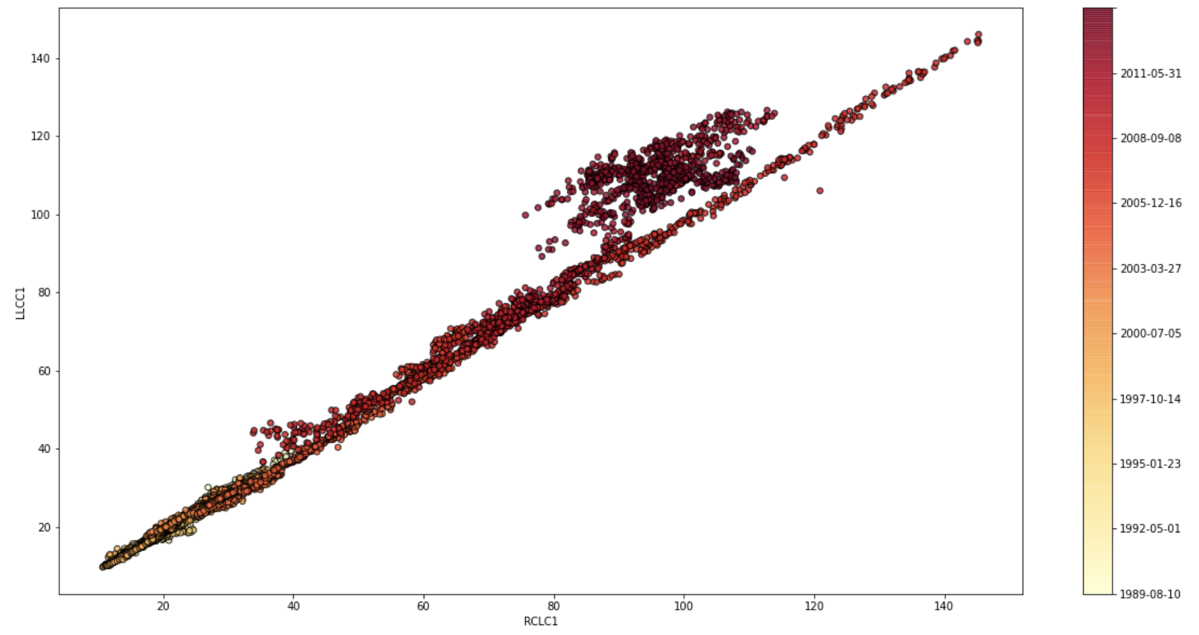
3. Hedge Ratio
WTI vs. Brent front month (1989-2014)

Slide 15
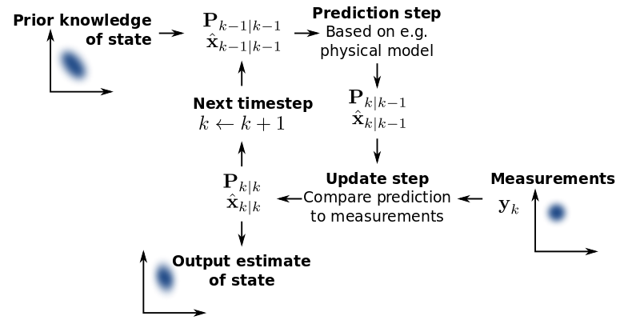
3. Dynamic Hedge Ratio
Using a Kalman Filter to dynamically update the hedge ratio (pykalman package)
Has been used to great success in statistical arbitrage and pairs trading strategies (Xu 2017, Benhamou 2016)

Slide 16
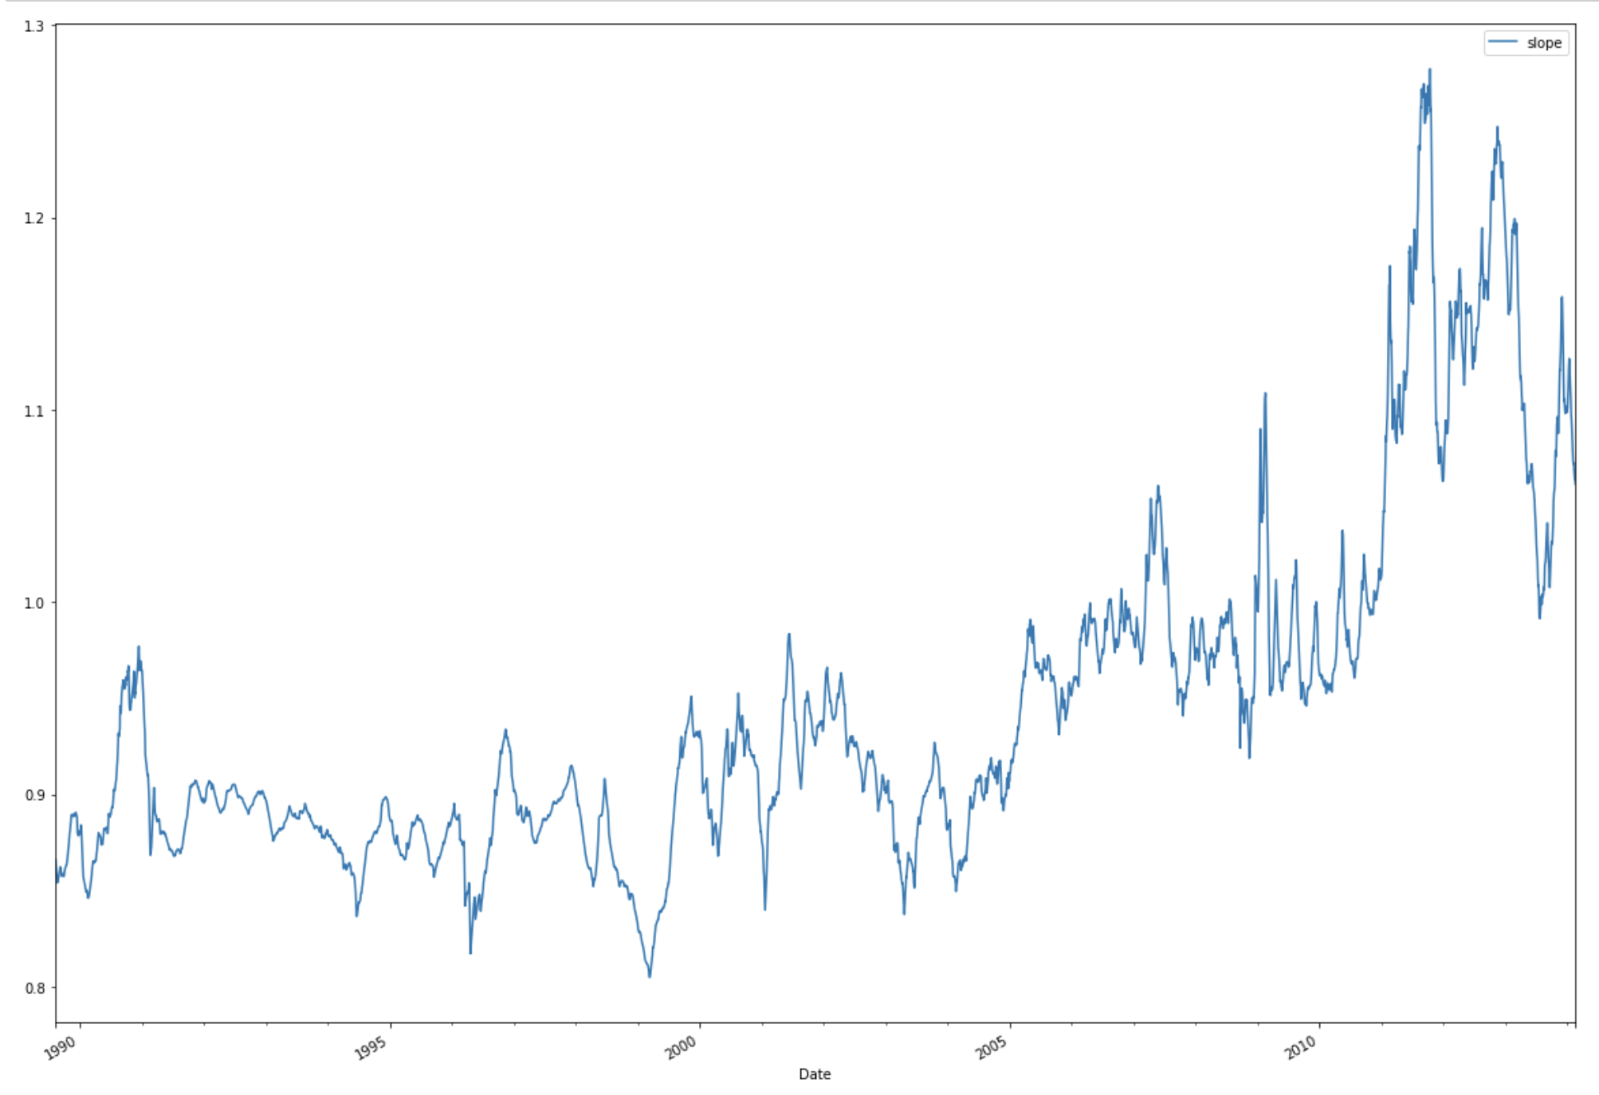
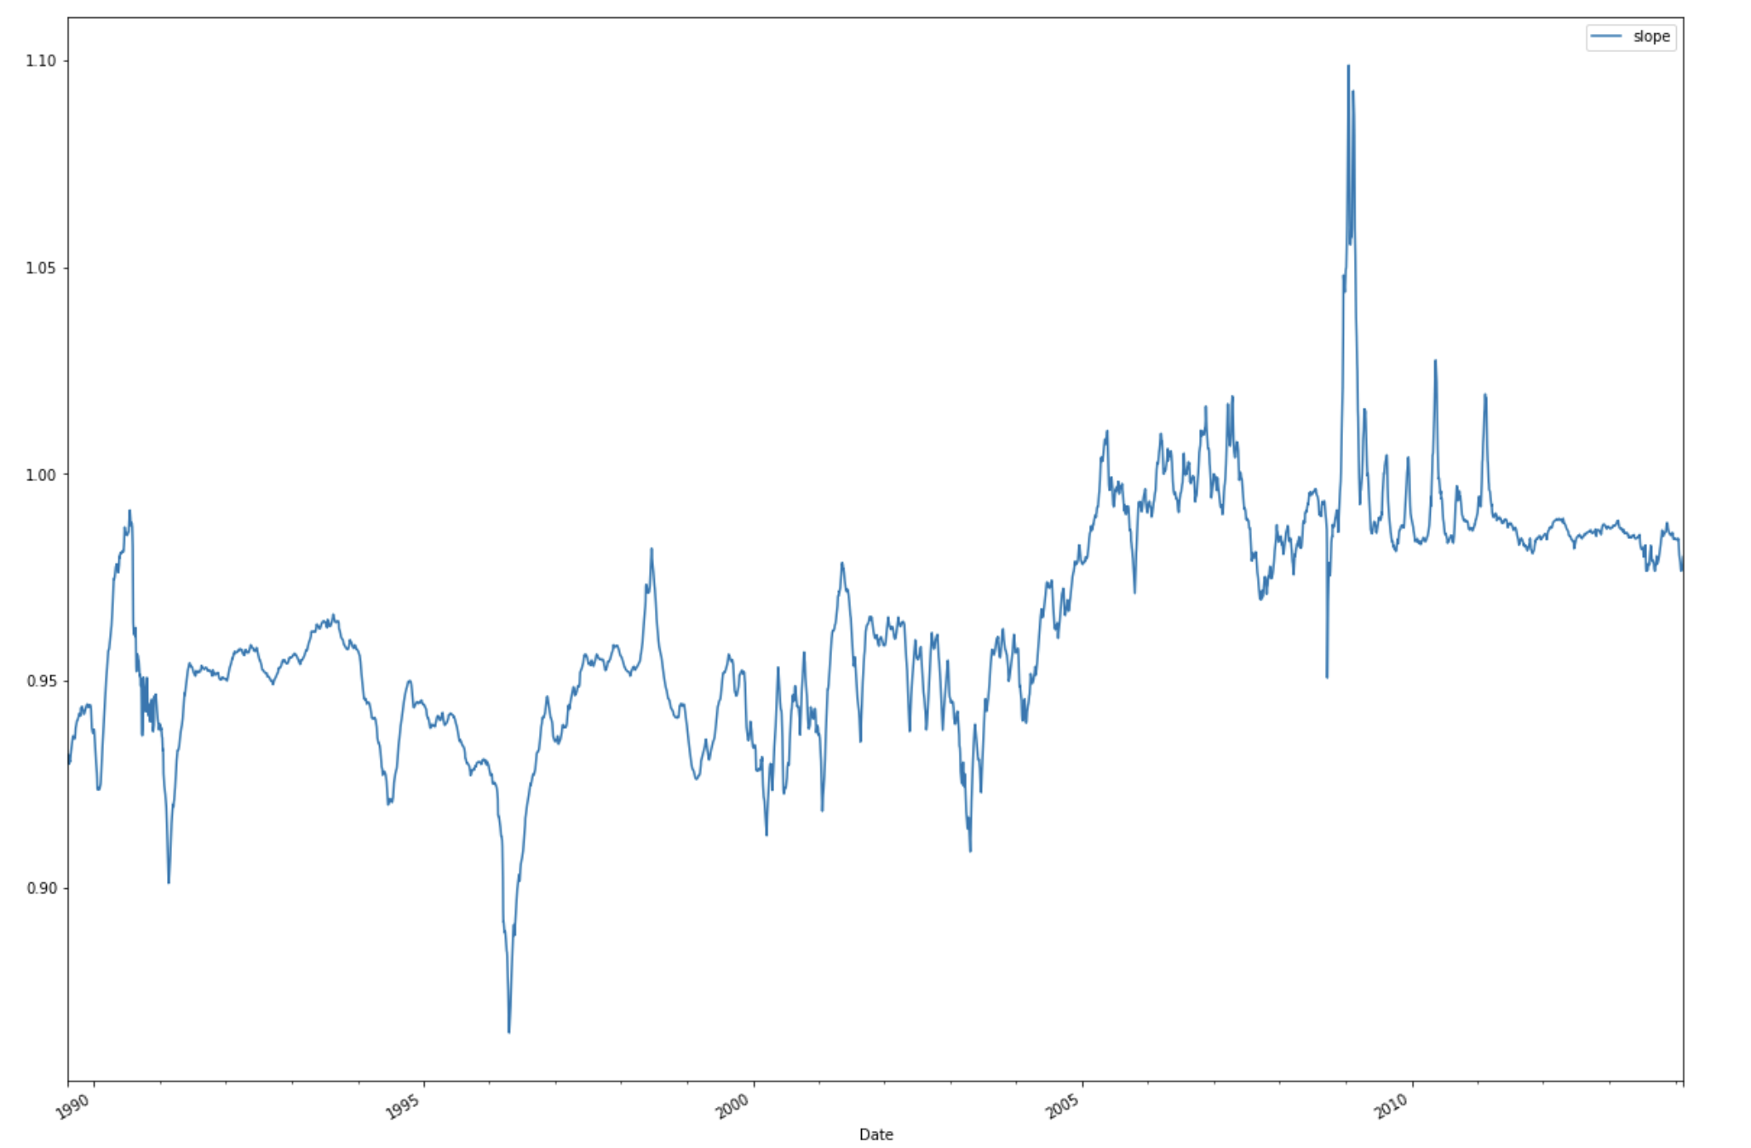
3. Dynamic Hedge Ratio
WTI-Brent 1-month Spread
WTI Front - WTI 2nd Spread
Crude Spread hedge ratio:
more volatile with wider range, changing from <1 to >1
Calendar Spread hedge ratio :
<1 at most of time, fluctuate within a narrower range
>1 when market is extremely volatile

Slide 17
3. Volatility Strategy
We created quintiles for the volatility of the returns for 51 contracts at each date.
Strategy 1 : Buy when volatility is low, sell when volatility is high.
Buy futures contracts in quintile 1 and and sell contracts in quintile 5.
Strategy 2 : Buy when volatility is high, sell when volatility is low.
Buy futures contracts in quintile 5 and and sell contracts in quintile 1.
Time Horizons: Volatility calculated over 1 week, 1 month and relative volatility.
Dataset
Combined datasets for 4 commodities: Crude oil, Gasoline, Heating oil, Natural gas
Dates for which we had data for all commodities:
2005/10/03 -- 2014/02/18

Slide 18
3. Momentum Strategy
We created quintiles for the momentum of the returns for 51 contracts at each date.
Strategy : Buy when momentum is high, sell when momentum is low
Time Horizons: Momentum calculated over 15 days, 30 days and 45 days
Dataset
Combined datasets for 4 commodities: Crude oil, Gasoline, Heating oil, Natural gas
Dates for which we had data for all commodities:
2005/10/03 -- 2014/02/18

Slide 19
SECTION 04
Testing

Slide 20
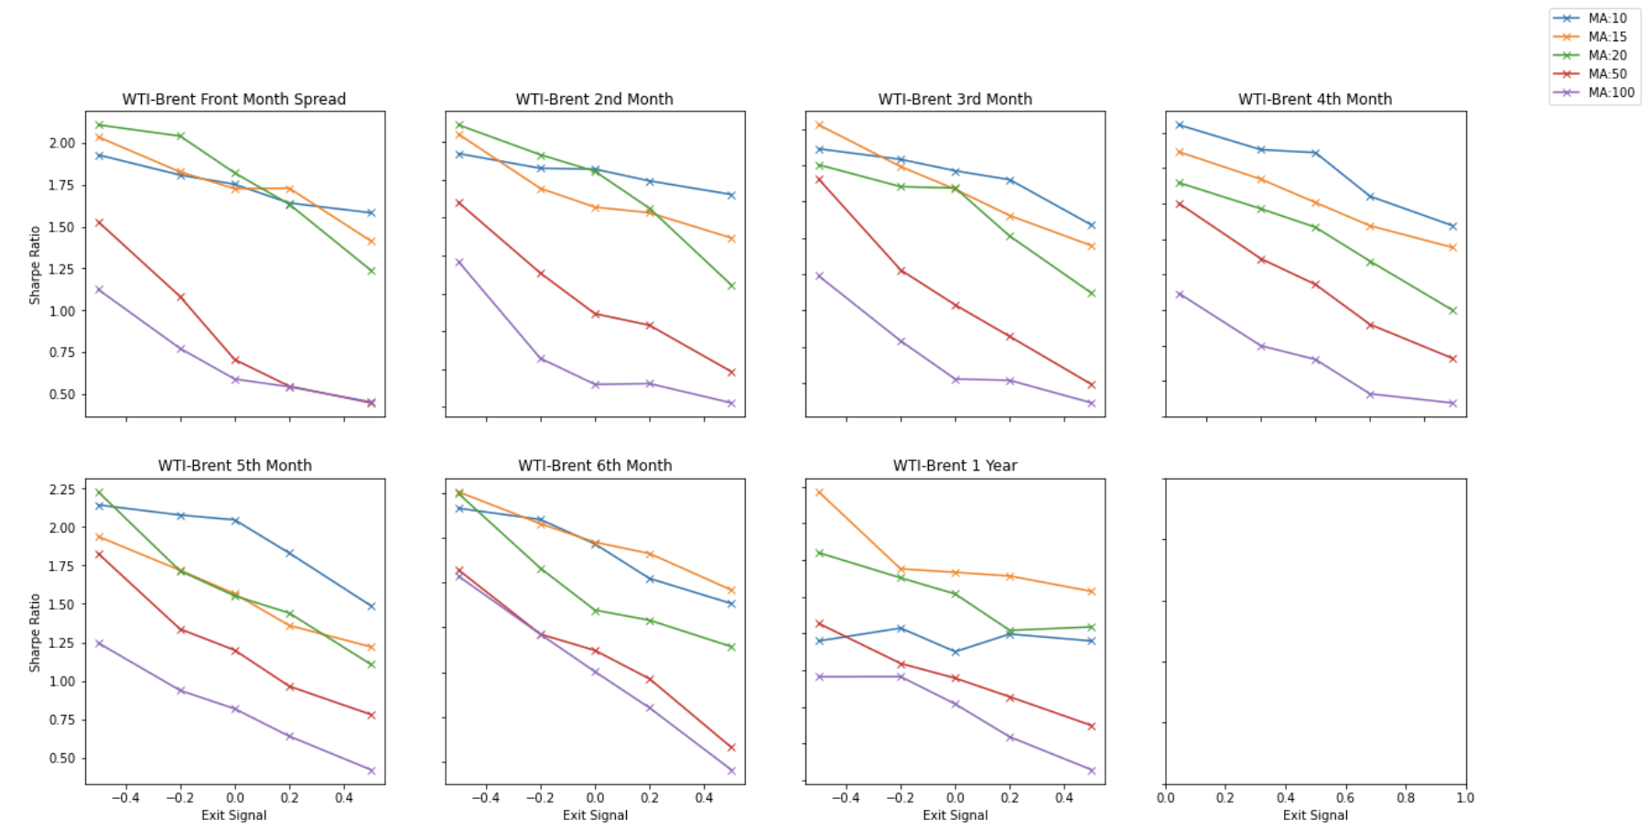
4. Mean-Reversion Strategy
Variation 1: No hedge ratio
Shorter MAs tend to work best (10-20 day)
Faster exit signals work best

Slide 21
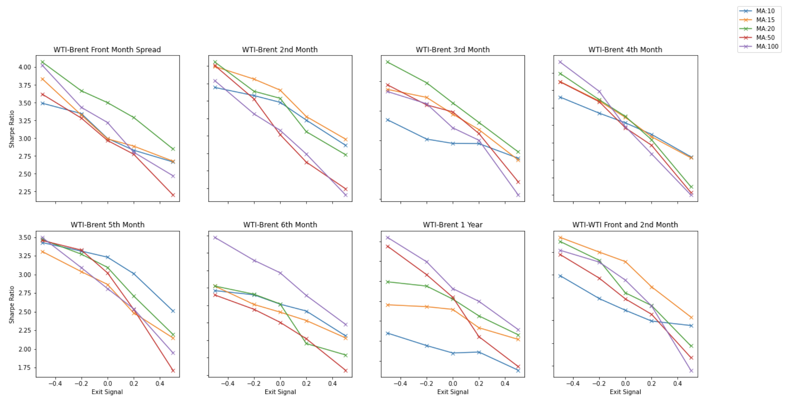
4. Mean-Reversion Strategy
Variation 2: Dynamic hedge ratio Inter-commodity spreads
At near term expiry dates, MA period doesn’t seem to matter much
For longer term expiry (0.5-1 year), long MA periods outperform
Faster exit signals still outperform

Slide 22
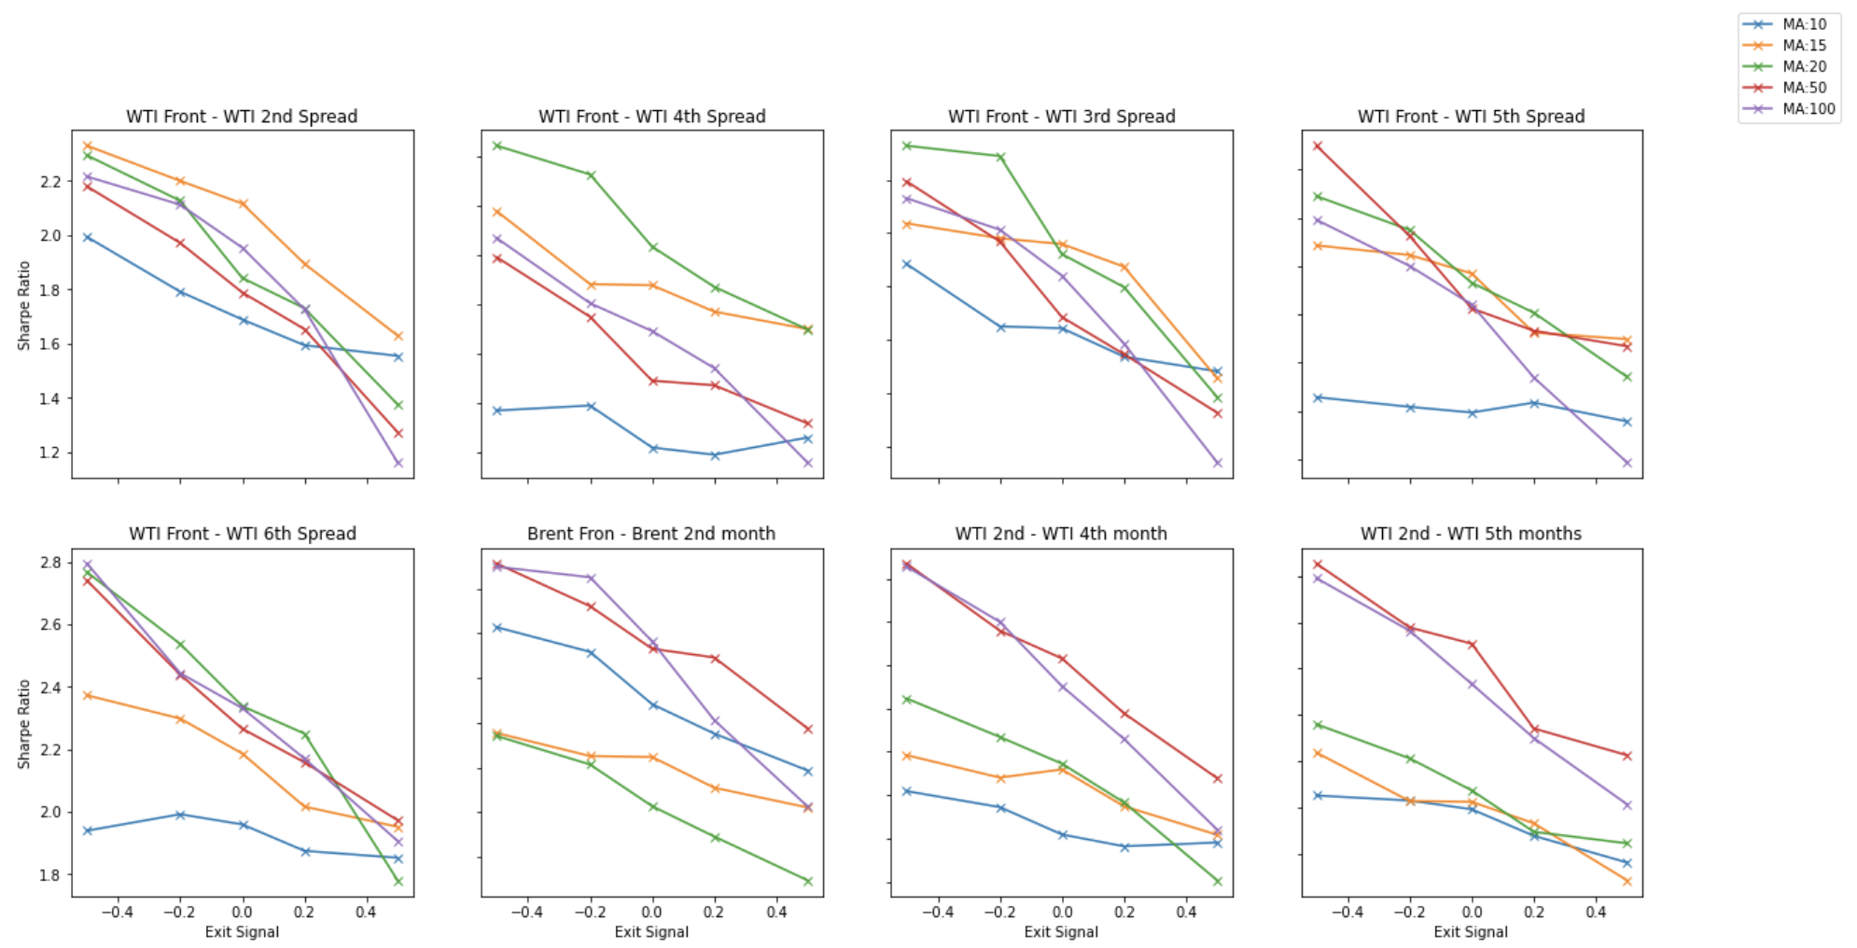
4. Mean-Reversion Strategy
Variation 2: Dynamic hedge ratio Calendar Spreads
Shorter MAs work best for spreads on the WTI front month
Opposite is true for 2nd month spreads

Slide 23
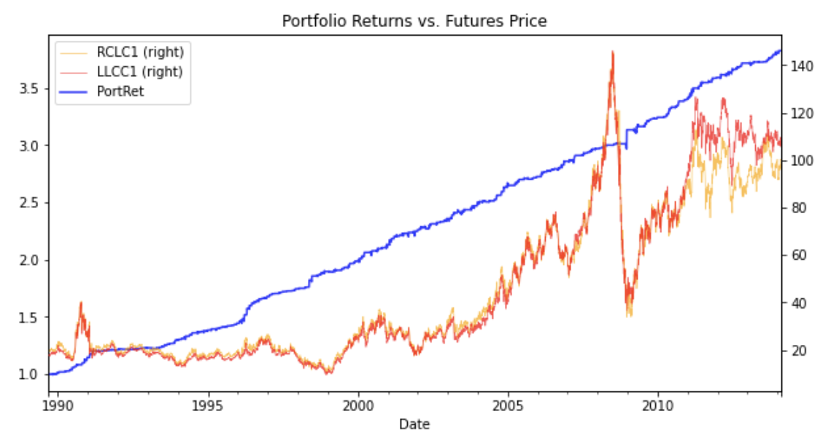
4. Mean-Reversion Strategy
WTI-Brent Front Month (MA20, Exit=0)
Max Drawdown: -1.7%
Number of trades: 284
Up days: 61.2%
Time in market: 22.5%
Average holding period: 5.2 days
3.8x return over 25 years (around 6% annualized)
Extremely low risk/volatility
Although returns themselves seem mediocre, have to take into account that futures can be highly levered
i.e currently roughly 10:1 leverage on WTI
($4500 required margin vs. $43k exposure)

Slide 24
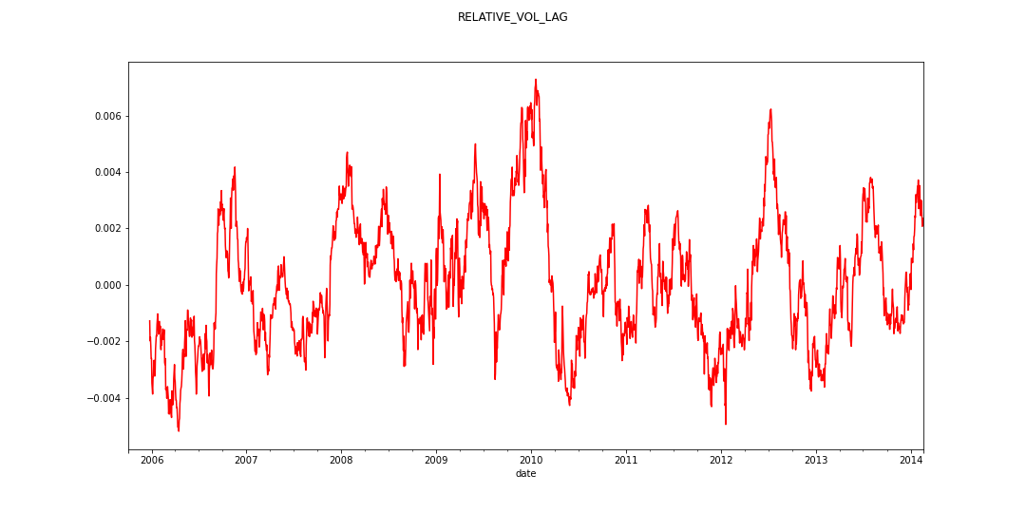
4. Volatility Strategy
Strategy 1: Buying when volatility is low yields negative Sharpe ratios
Strategy 2: Buying when volatility is high does better
Relative volatility performs best (Sharpe Ratio 0.14)
Overall volatility is not a good strategy

Slide 25
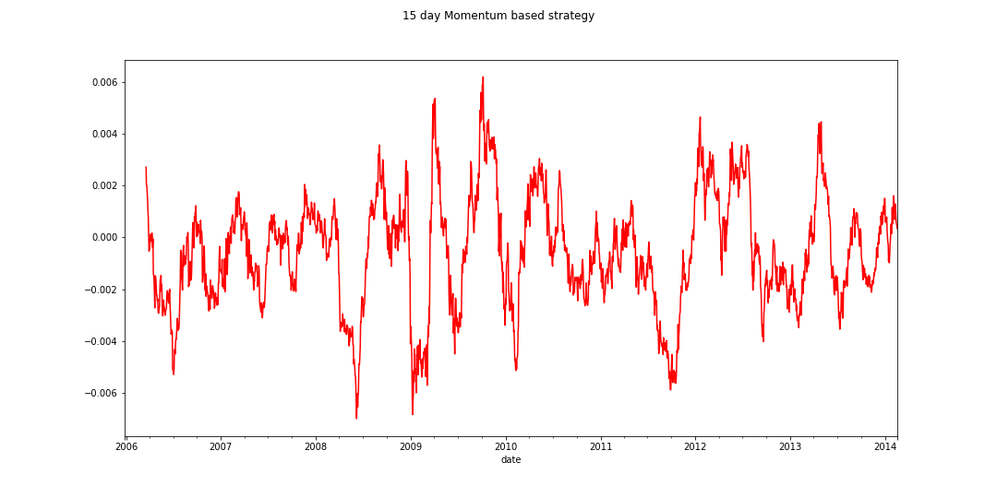
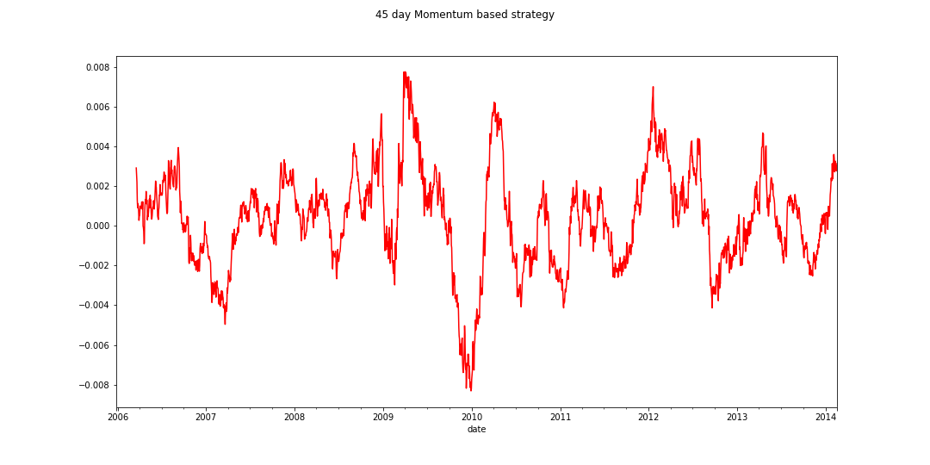
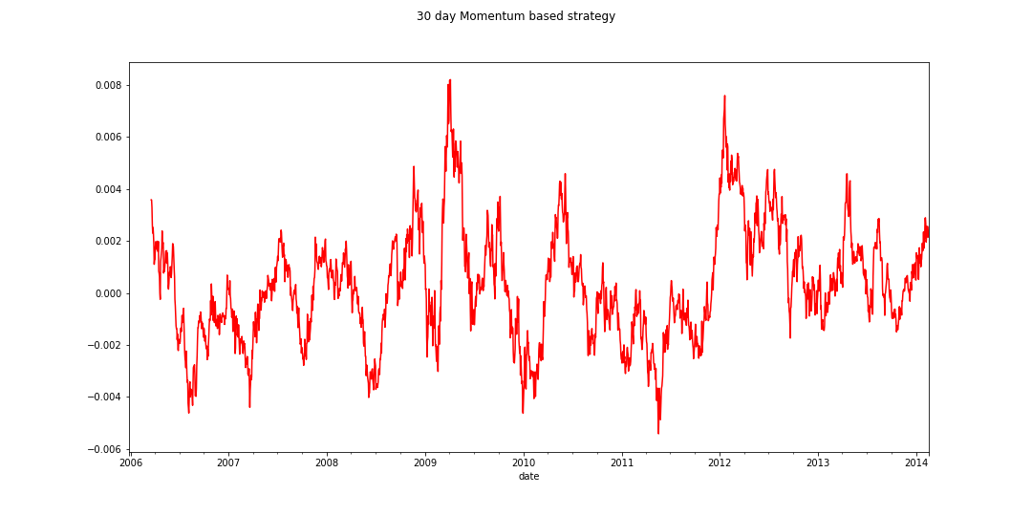
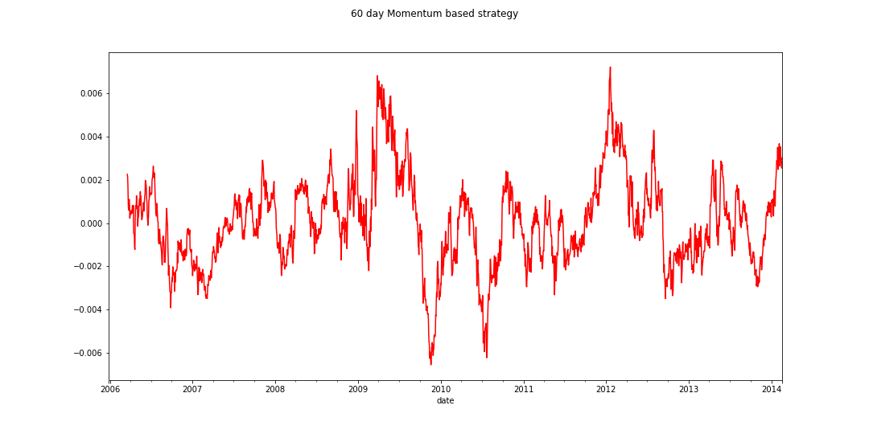
4. Momentum Strategy
Momentum Based Trading Strategies: Varying Time Horizons
45 day momentum performs best (Sharpe Ratio 0.08)
Returns resemble random noise
Overall Momentum is not a strong strategy for this set of commodities

Slide 26
Future Work
Transactions Costs/Slippage
Intra-day
Data
1
2
Try other futures contracts
Recent performance
(2015-2020)
3
4

Slide 27
Thank You
Let us know if you would like to contribute capital to our fund!

Slide 28
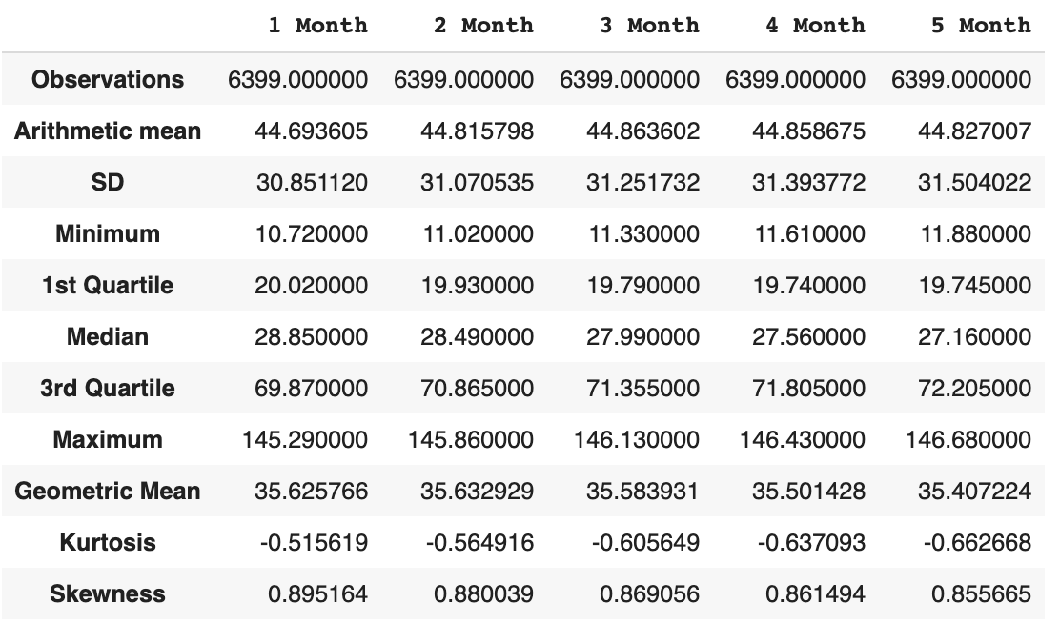
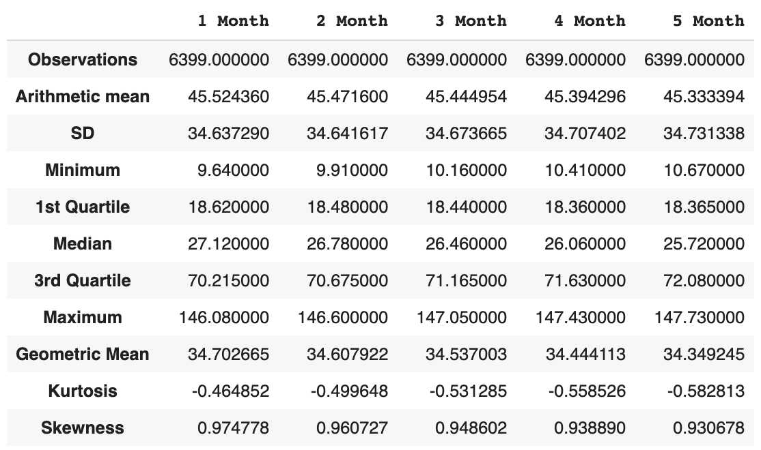
Appendix
Summary Statistics of Nearest 5-month Contracts for WTI and Brent Crude Oil
WTI
Brent

